Slide 1
abm new website design（2）
Tony Liu

Slide 2
ANALYSIS all products
Section A

Slide 3
3 Big Categories
Genes
Cell Biology
General Biology
Gene | Sku/Name | Category | Filter Attributes | Specification
 | Sku/Name | Category | Filter Attributes | Specification
Reagents
 | Sku/Name | Category | Filter Attributes | Specification
Custom Service & Lab Equipment
 | Sku/Name | Category | Custom Request | Specification

Slide 4
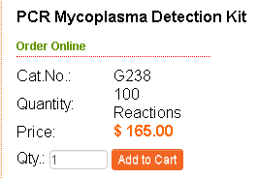
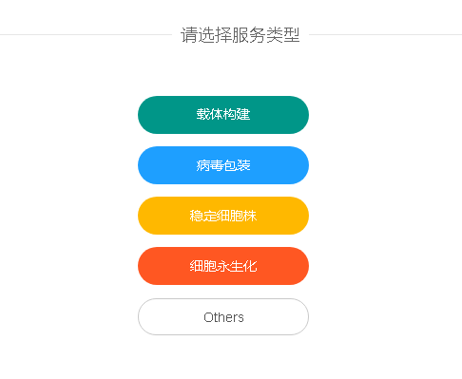
3 Big Categories
Genes / Cell Biology / General Biology(Reagents)
Sku and name can be indexed for cart.
Custom service / Lab equipment
Submit form as quote, and the quote can be created an order.
Sku | Name

Slide 5
Database Structure
Genes
Genes
gene_table
Cell Biology
non-gene_table
General Biology
general_table
Custom request form → Quote
Bundle Products
bundle_table
Gene_table
Non-gene_table
General_table
Bundle_table
Sku | Gene id | Cate Ids | Specification
Reagents
Category
Custom Service & Lab Equipment

Slide 6
Database Structure
Catalog tables
Id | Table name | description
1 | tb_genes | All gene data
2 | tb_category | All categories
3 | tb_catalog_library | All gene library products
4 | tb_catalog_cell_biology | All cell biology products
5 | tb_catalog_material | All material products
6 | tb_catalog_bundle | All bundle products
7 | tb_catalog_index | All products indexer for cart
Gene name, id, info
Cate name, id, description
Sku, gid, cid, soldNum, inventory,
other info
The same as 3
The same as 3
Sku, gid, cid, soldNum, inventory,
other info, bundle items
Sku, name, price, inventory,
other info

Slide 7
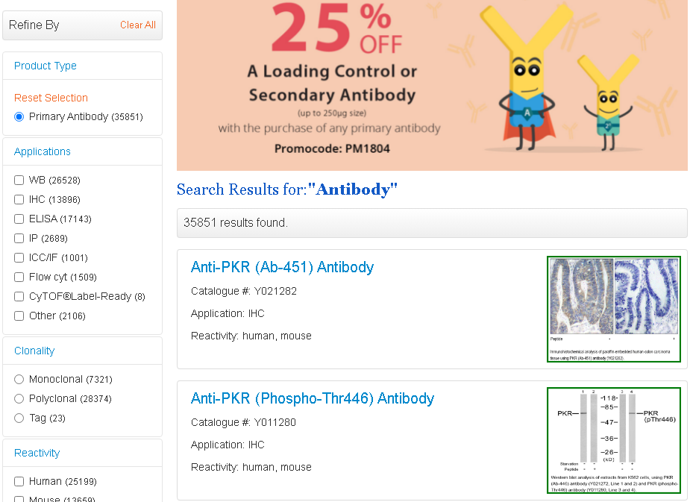
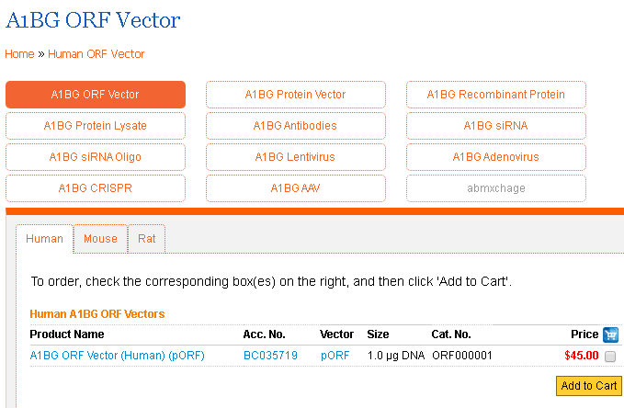
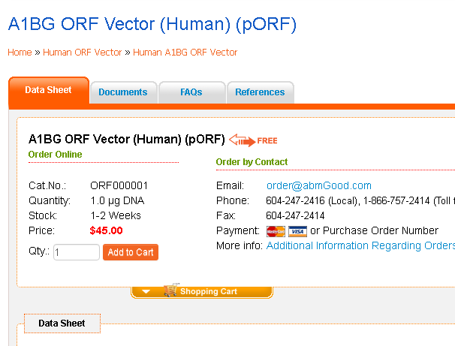

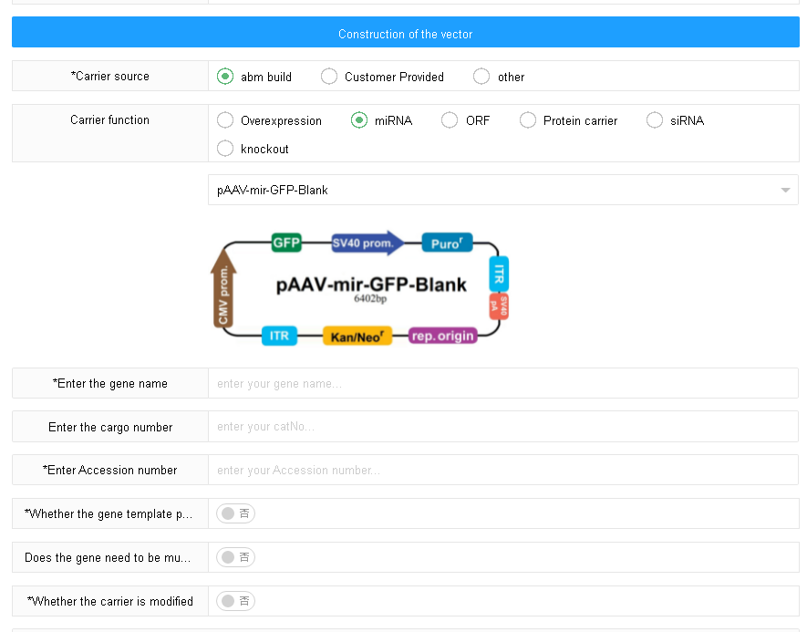

Page view
Product list page
Gene page
Detail page
Category home page
Custom service
Equipment

Slide 8
New website search engine
Section B

Slide 9
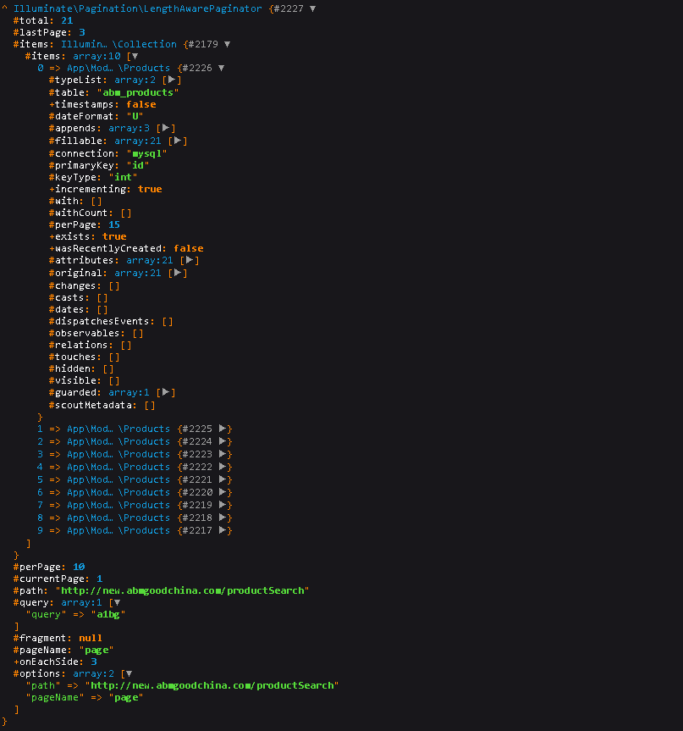
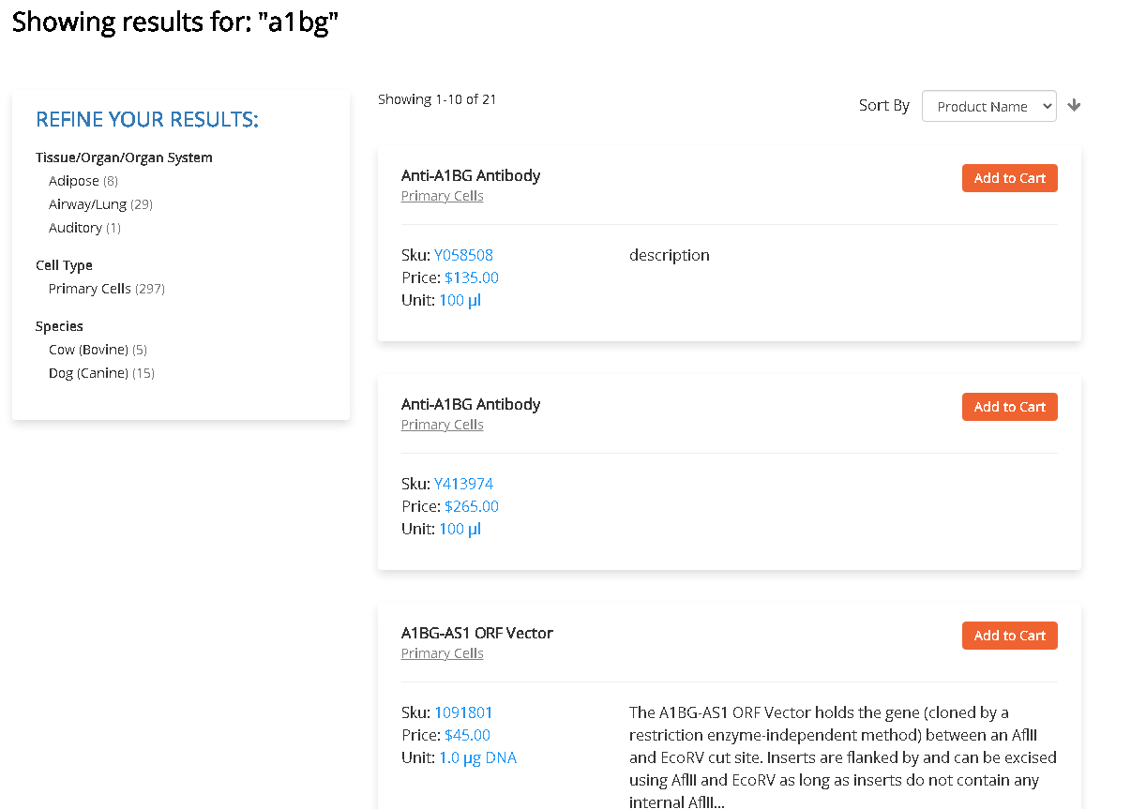


Laravel Scout-elasticsearch
Elasticsearch became the most popular search engine.

Slide 10
New website processing
Section C

Slide 11
New website processing
Login & Regesiter
CMS pages
url redirect
Laravel ES search engine
Catalog & catalog search page
Catalog data & options general
Cart function
Order function
Inventory management
CSL function
Order shipment & invoice
Other function

Slide 12
The End

